Slide 1


Slide 2

NLP Chatbot Development using Dialogflow

Slide 3
Group Members Introduction
Name: Hassam Khan
VU ID: BC210414987

Slide 4

INTRODUCTION OF PROJECT
Chatbots are becoming an indispensable tool across various industries such as customer service, healthcare, education, and e-commerce, owing to their ability to operate 24/7, handle multiple queries simultaneously, and offer instant support. These features make them highly valuable in today’s fast-paced digital world. The focus of this project is to design and develop an intelligent, interactive chatbot using Google Dialogflow, a powerful Natural Language Processing (NLP) platform. The chatbot will aim to automate customer interactions, providing timely, relevant responses, and enhancing the overall user experience. To ensure the chatbot is both functional and industry-specific, students will choose one of three case studies: Training & Education Services, Pharmacy Retail, or Restaurant and Food Services. By customizing the chatbot for a particular industry, students will have the opportunity to apply cutting-edge AI technologies to solve real-world business challenges, such as booking training sessions, managing pharmacy inquiries, or processing food orders and reservations, while gaining hands-on experience in NLP and backend integration.

Slide 5
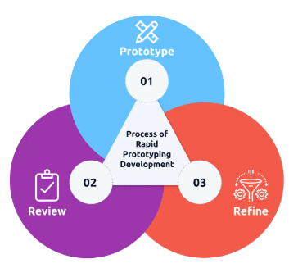
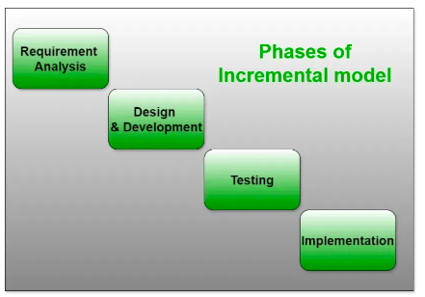

Slide 6
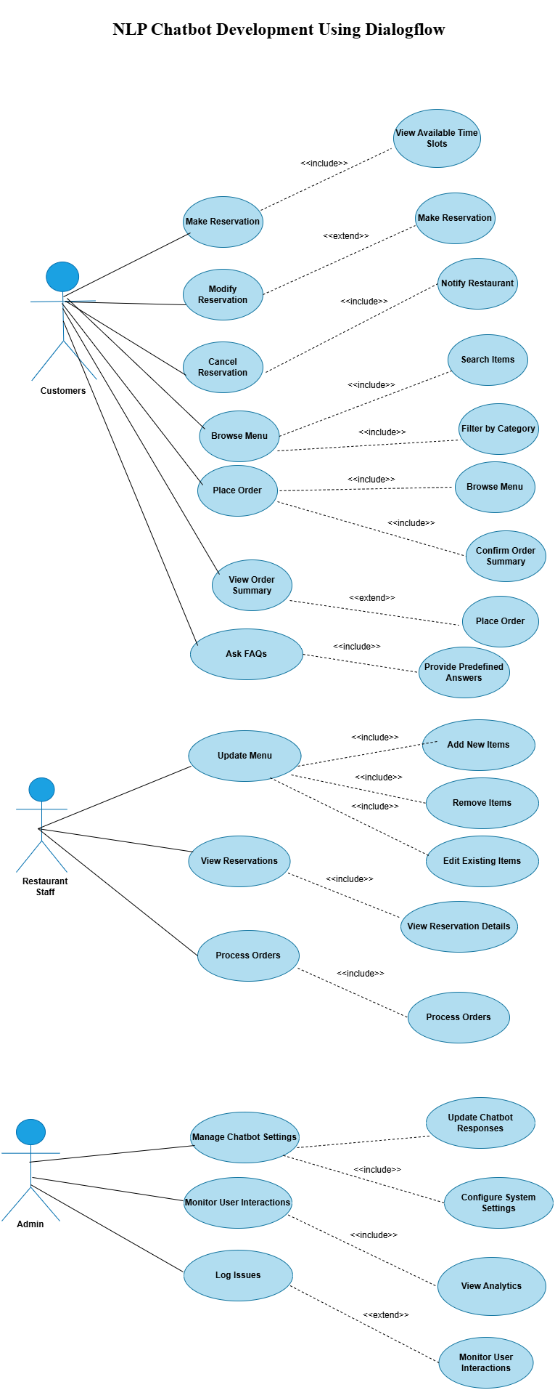
Use Case Diagram

Slide 7
Business Rules Catalog
The primary goal of this project is to design and develop an AI-powered chatbot that effectively understands and responds to user inquiries using Dialogflow, a prominent tool in natural language processing (NLP). Through this project, students will:
Identify a Real-World Case Study: Choose a specific domain (Training Company, Pharmacy Store, or Restaurant) to explore the unique needs and challenges faced in that industry.
Define the Problem: Analyze the chosen case study to clearly articulate the specific problem or inefficiency that the chatbot aims to address, detailing how its implementation can enhance operational processes and improve user experiences.
Build an Interactive Chatbot: Develop a functional chatbot that not only answers queries but also performs key tasks such as making reservations, processing orders, or addressing frequently asked questions (FAQs). The chatbot should engage users in a conversational manner, ensuring a seamless interaction that meets their needs.

Slide 8
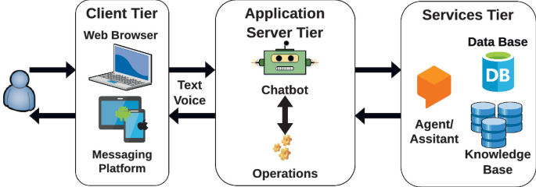
Architectural Design

Slide 9
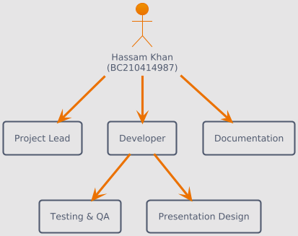
Team Structure

Slide 10
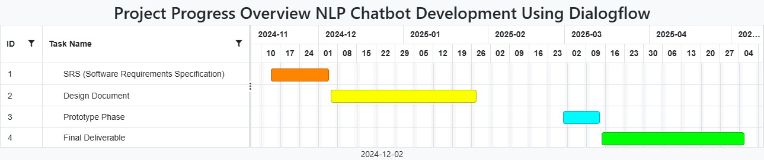
Project Schedule

Slide 11
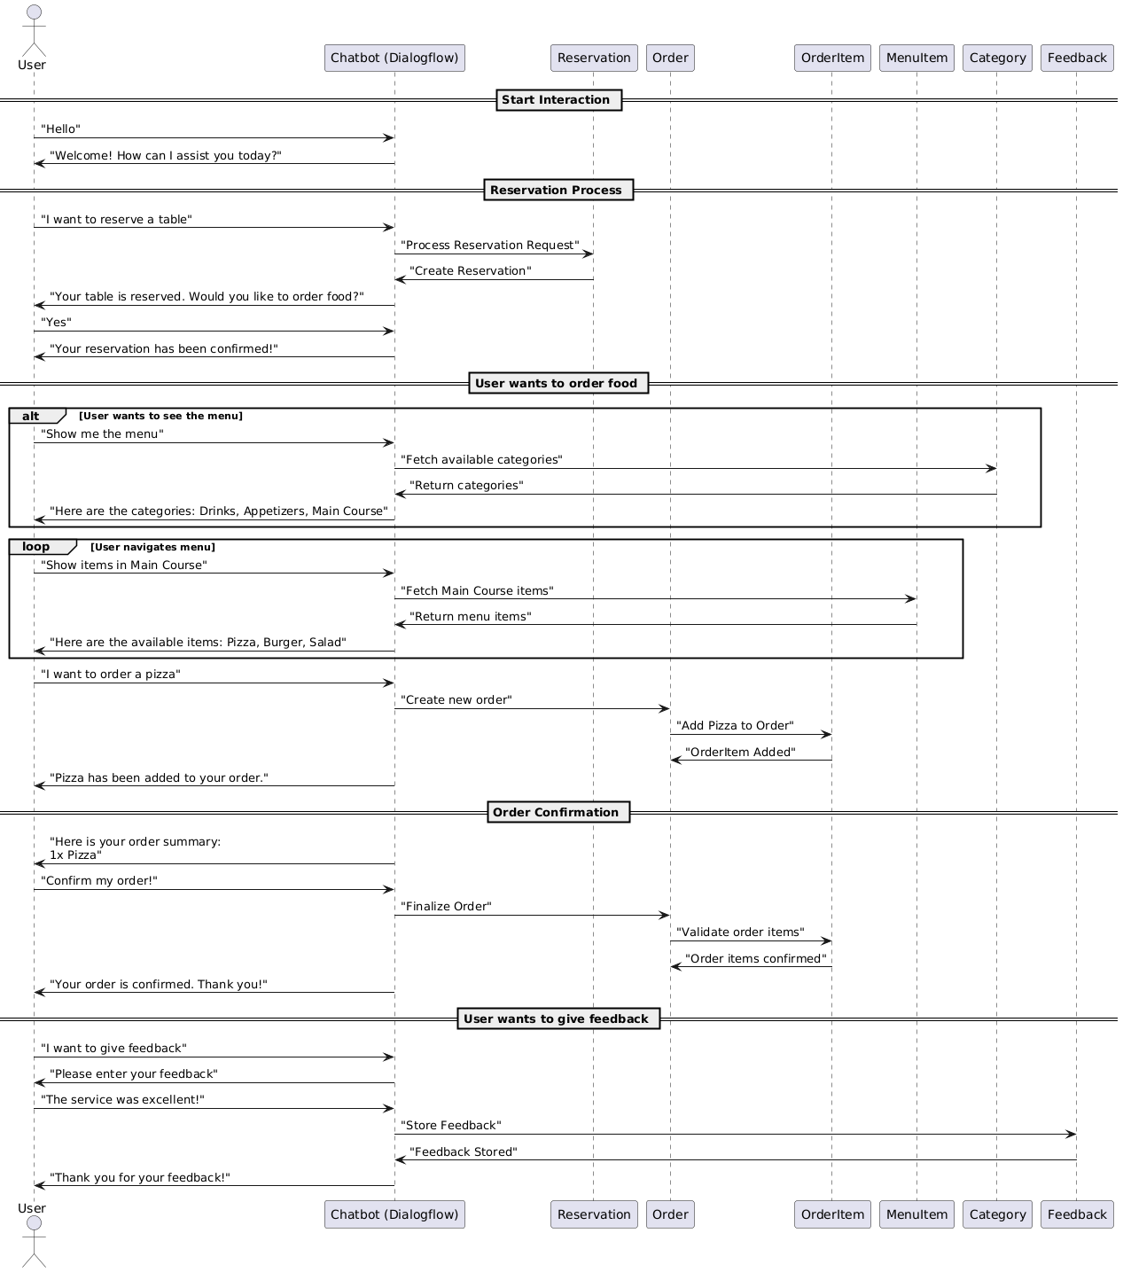
Sequence Diagrams

Slide 12
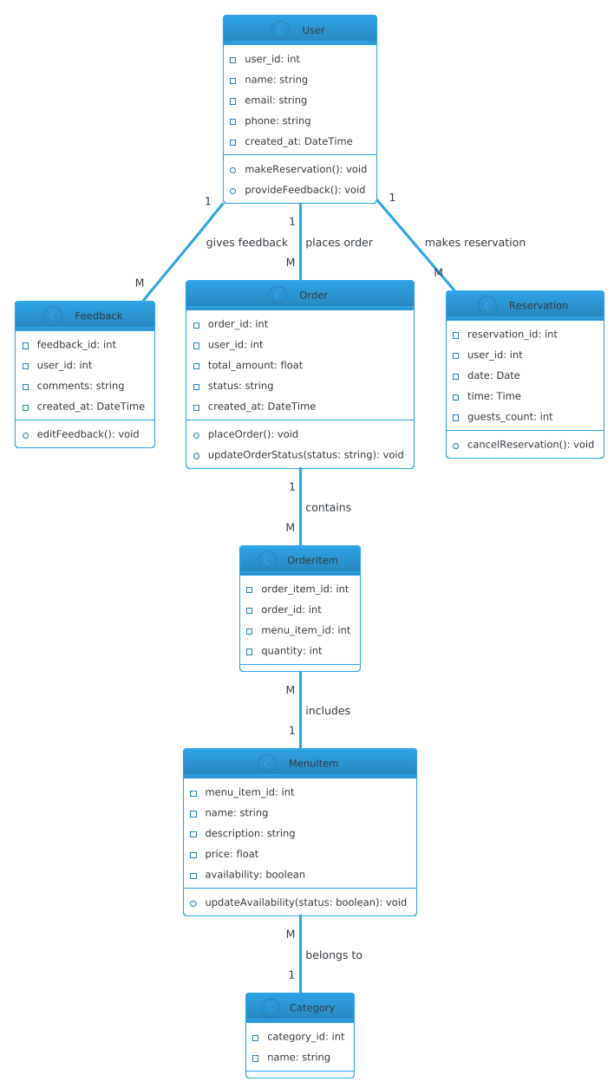
Logical Model/Class Diagram

Slide 13
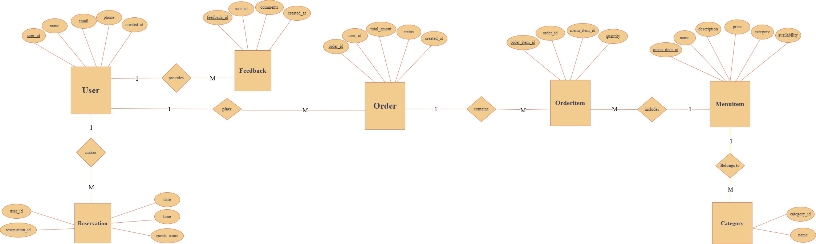
Entity-Relationship Diagram

Slide 14
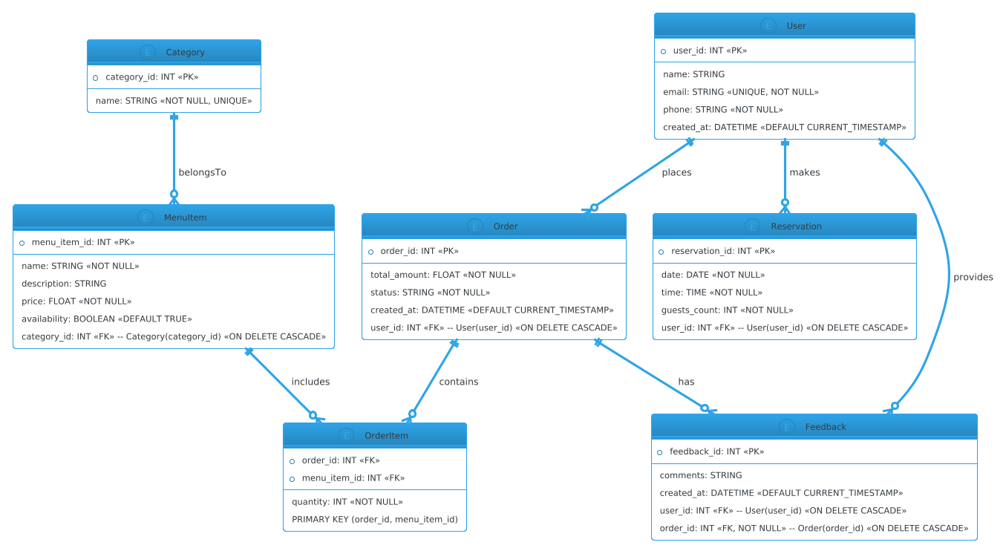
Database Diagram

Slide 15
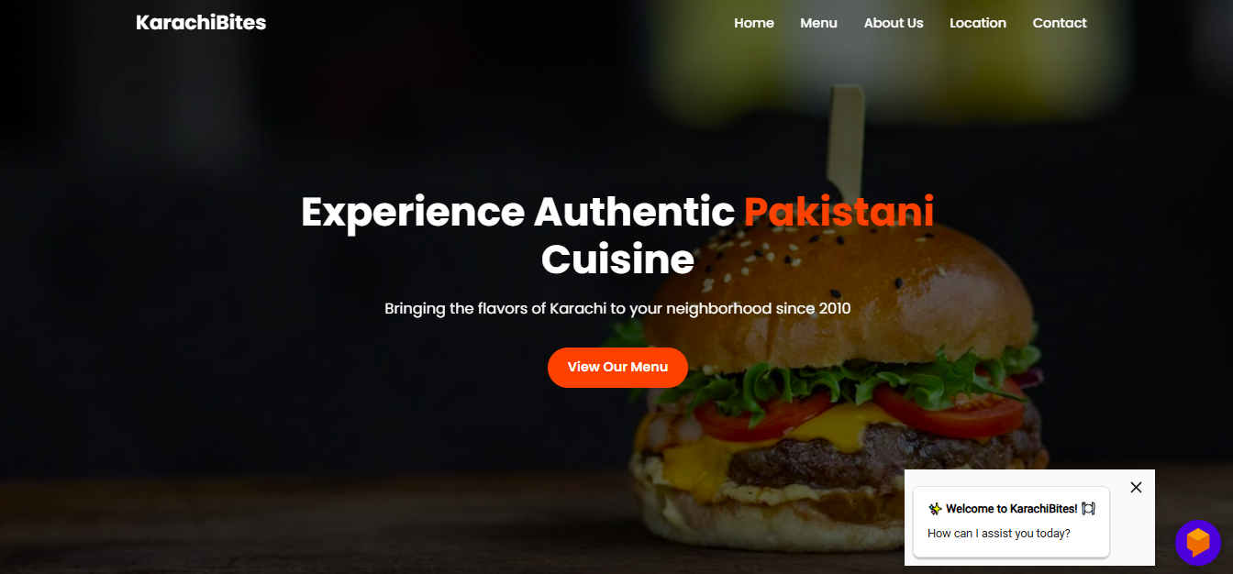
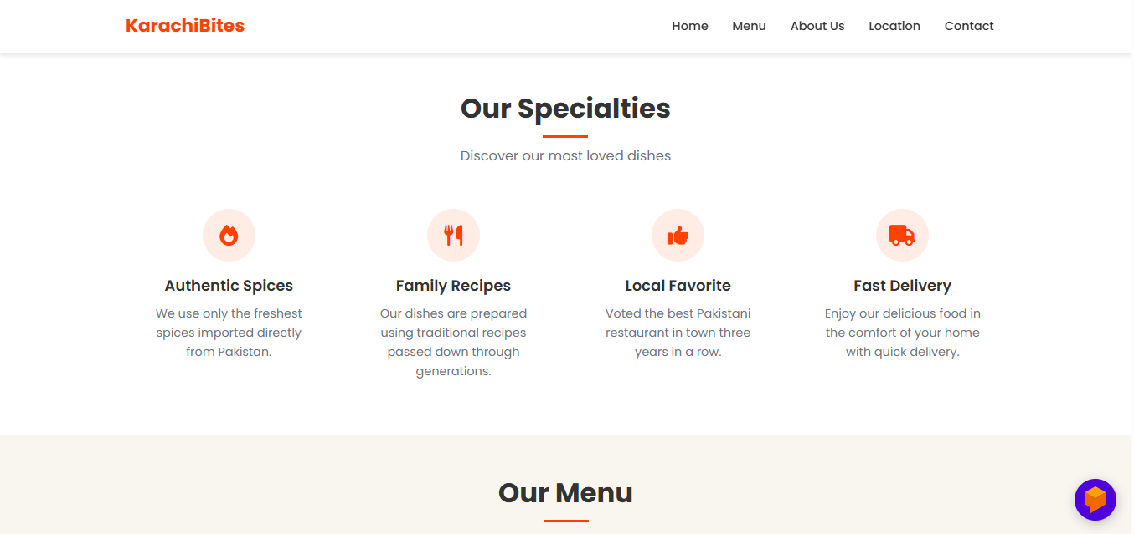
User Interfaces

Slide 16
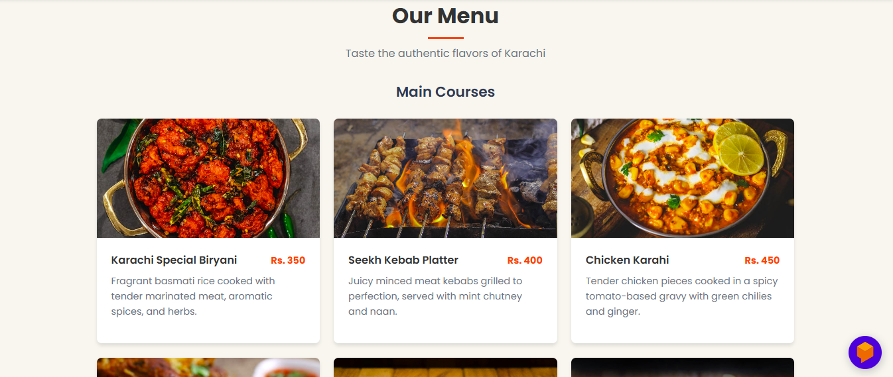
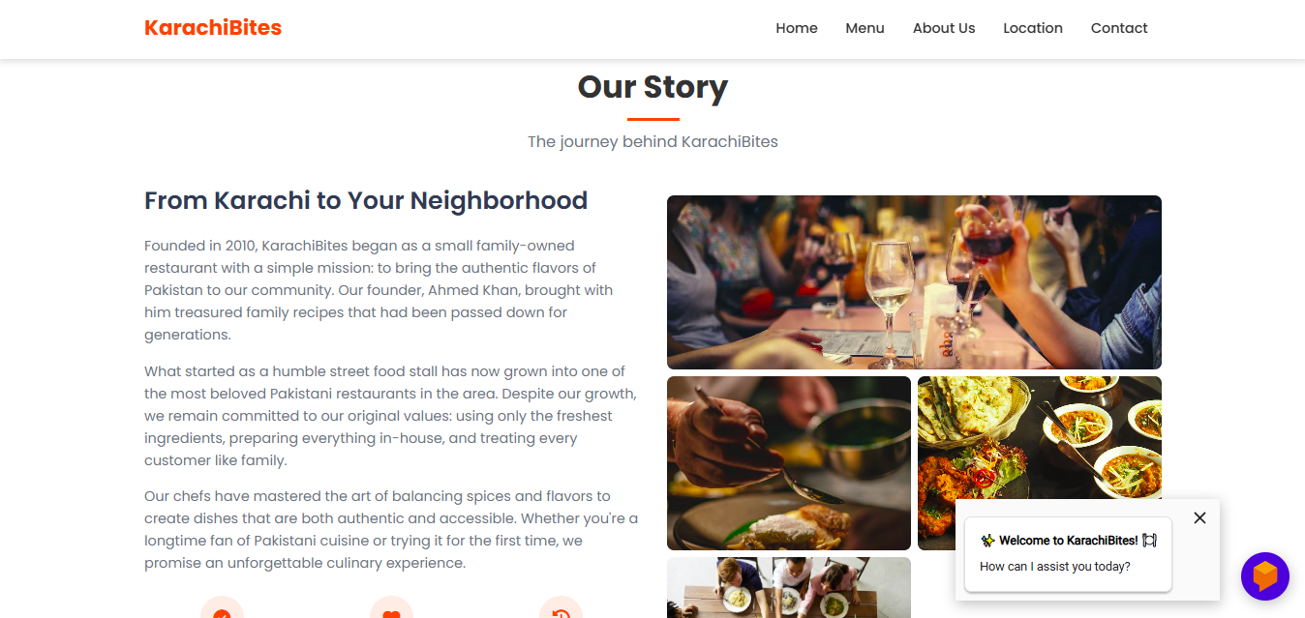

Slide 17
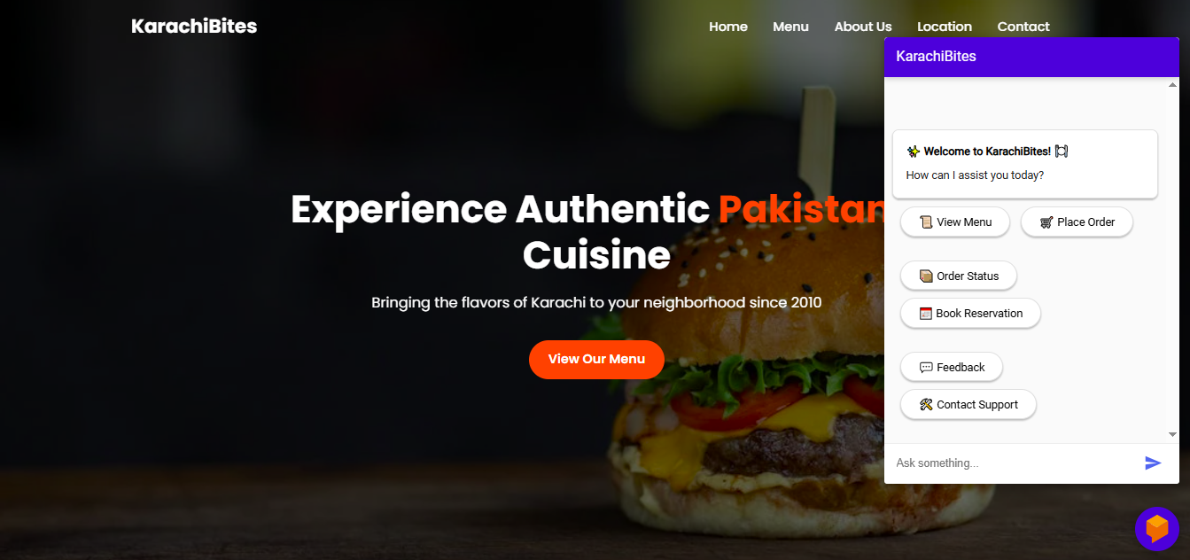
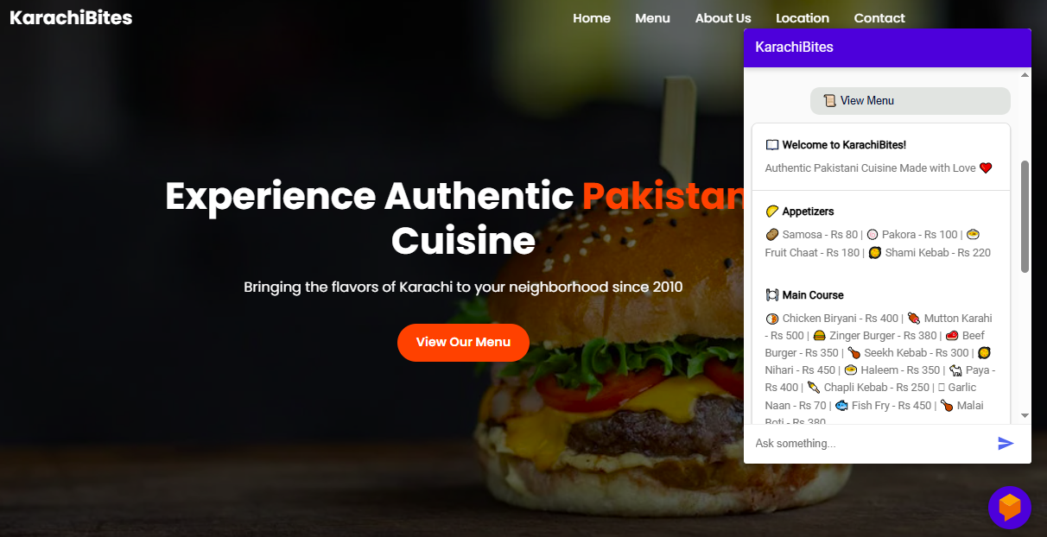

Slide 18
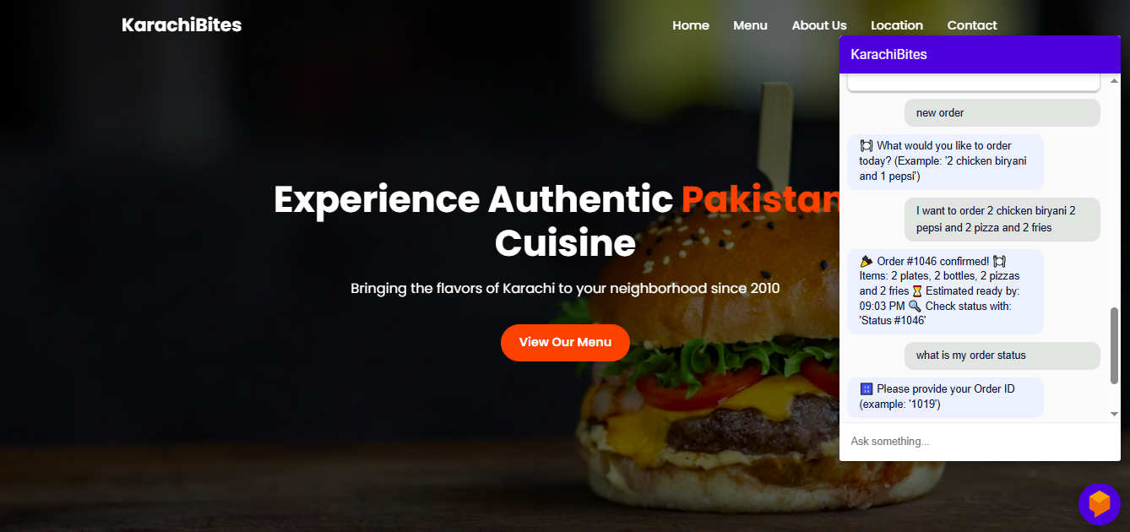
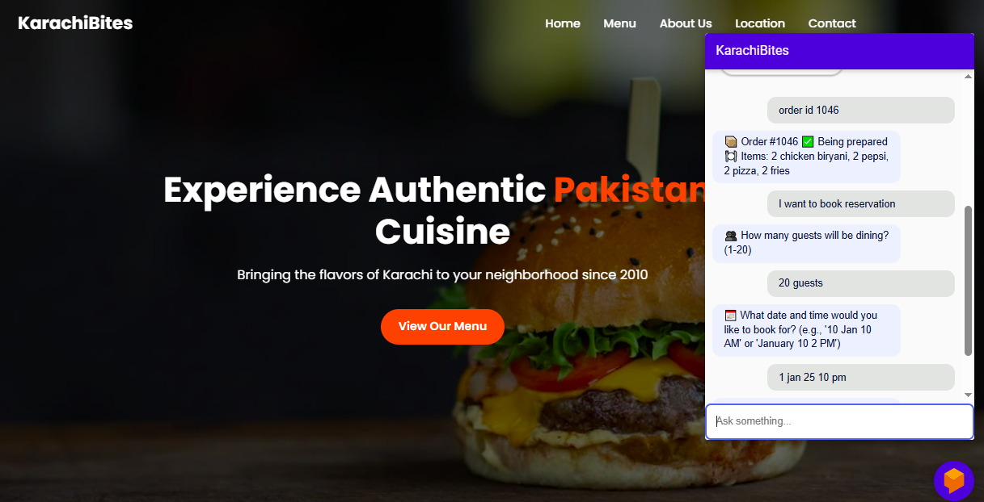

Slide 19
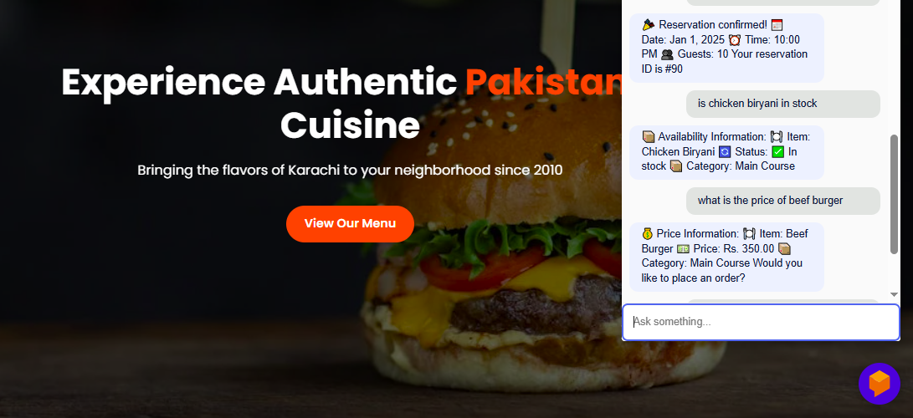
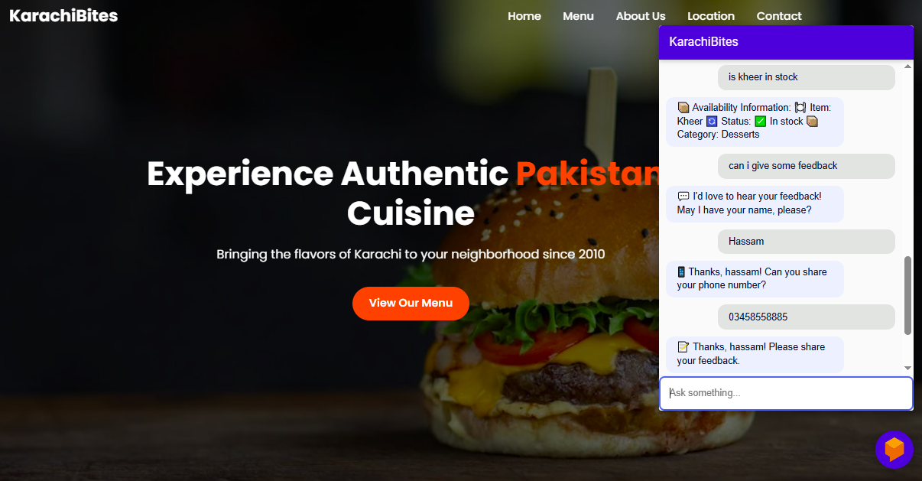

Slide 20
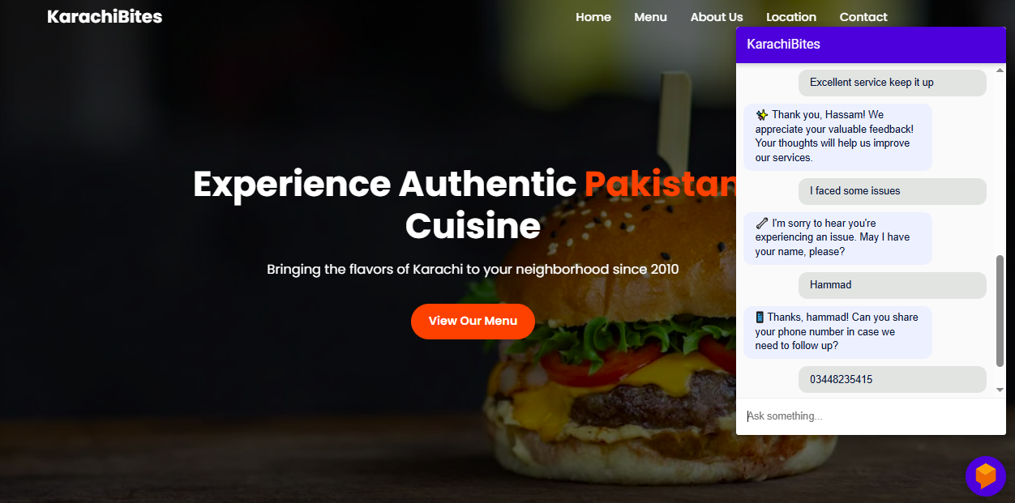
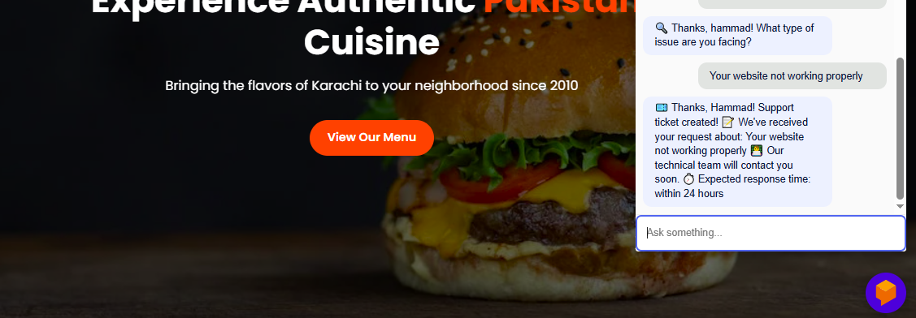

Slide 21
Tools
Google Dialogflow
Python
Fast Api
MySQL
HTML
CSS
JavaScript
Ngrok
Visual Studio Code

